Slide 1
Self Embedding Watermarking System
Advisor: Dr. Asif Mahmood Gilani

Slide 2
Outline
Introduction
Problem Statement
Our Solution
Literature Review
Methodology
GUI
Prototype Results
Work Breakdown and Timelines
Summary

Slide 3
Introduction
What is watermarking?
Image Tampering
Video Tampering
Temporal Tampering
Spatial Tampering
Image Reconstruction
Video Reconstruction
Notes:
Not same as adding logo over image but its DIGITAL WATERMARKING
Temporal Tampering: Manipulating frame sequence
Spatial Tampering: Manipulating objects in frame

Slide 4
Problem Statement
Due to the availability of various editing software to tamper with any image or video, the authenticity of such media can be questionable.
This can create authenticity issues in various areas such as:
Evidence for prosecution in criminal cases
Copyrights on social media content
Online scams
Notes:
Online scam as in editing someone’s image/video and conspiring against them (scandal)

Slide 5
Our Solution?
The main concern gathered from our problem statement includes authentication and recovery of watermarked content. To deal with this problem, our team is developing a watermarking system which not only detect the image and video tampering but also restore them.

Slide 6
Literature Review
Image Watermarking
Triple Recovery Information Embedding Approach
Pixel-wise Authentication Based Self-Embedding Fragile Watermarking Method
Hash Function Based Fragile Watermarking
Video Watermarking
Video-Tampering Detection and Content Reconstruction via Self-Embedding
Spatiotemporal Trident Networks: Detection and Localization of Object Removal Tampering

Slide 7
Image Watermarking
In image watermarking the original image is divided into its smallest bits where the average values of the bits is calculated and hashed and then inserted into the LSB of the particular image block.
The process is similar in all methods with some differences.

Slide 8
Image Watermarking(Contd.)
No | Title | Year | results | Description
1 | A novel triple recovery information embedding approach for self embedded digital image watermarking | 2020 | Recovers up to 75% tampering rated images. | In this paper the image is first divided into 16x16 non-overlapping main blocks, after which a lookup table is generated from which four random main blocks, known as partner blocks, are chosen. Then, each partner block is divided into 4x4 blocks. Then the average value of the pixels of a partner block is hashed using MD5 and embedded into LSB of other partner blocks
2 | A novel pixel-wise authentication-based self-embedding fragile watermarking method | 2021 | Recovers up to 50% tampering rated images. | In this paper the original image is divided into four equal parts and then the four parts are divided into 2x4 or 4x4 parts. The recovery bits are formed by computing the average values of the divided blocks using XOR operation and combining them the four MSBs of the pixel, the recovery bit, and the two-pixel position bits are used to generate two authentication bits for each pixel. The authentication bits are then embedded in the pixel's first and second LSBs

Slide 9
Image Watermarking(Contd.)
No | Title | Year | results | Description
3 | A novel hash function based fragile watermarking method for image integrity | 2019 |  | In this paper the image is first divided into 32x32 non-overlapping blocks, which are then divided into 16x16 non-overlapping sub blocks. The 256-bit hash function SHA-256 value of the first three subblocks is then calculated using a hashing algorithm. The hash value 16x16 bit binary watermarked is then generated. The watermark computed by the first three subblocks is then modified in the fourth subblock. The same procedure is followed for all 32x32 blocks.
4 | Self-embedding fragile watermarking based on reference-data interleaving and adaptive selection of embedding mode | 2016 | 20% tampering rate tested. Images also had low PSNR value (quality of image was reduced) | In this paper the image is first divided into (𝑁/𝑏^2) (where N is assumed to be multiple of b) non-overlapping image blocks with sizes b x b, which is later allocated an authentication bit generated through a hash function SHA-256. These bits are then stored in the LSBs and are used as references when an image needs to be checked for any kind of tampering
25/01/2022
Self Embedding Watermarking System

Slide 10
Image Watermarking(Contd.)
No | Title | Year | results | Description
5 | Self-Embedding Fragile Watermarking Scheme to Detect Image Tampering Using AMBTC and OPAP Approaches | 2021 | Recovers up to 45% tampering rated images. | This method uses technique Absolute Moment Block Truncation Coding (AMBTC) for reconstructing tampered images by cropping attacks and forgery. Image is divided into 8x8 blocks The watermark is embedded in the pixels of the cover image using 3LSB and 2LSB, and the checksum calculated using MD5 is hidden in the LSB.

Slide 11
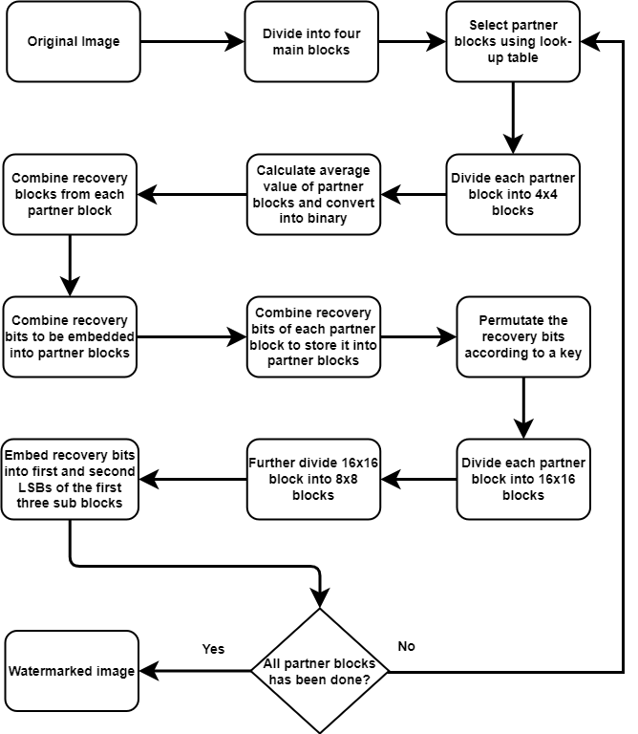
Image Watermarking(Contd.)

Slide 12
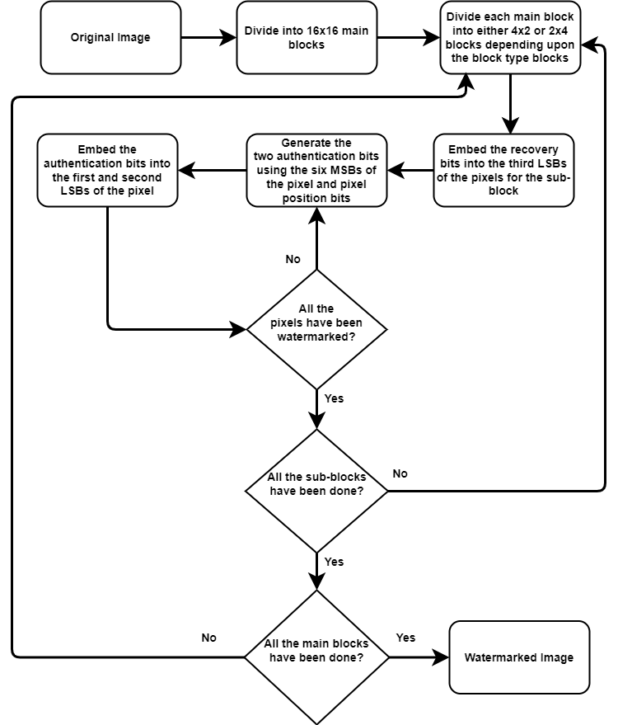
Image Watermarking(Contd.)

Slide 13
Video Watermarking
In video watermarking the first thing to do is to select the key frames from the video and then the same process as the image is applied and the key frames is divided into its smallest bits where the average values of the bits is calculated and hashed and then inserted into the LSB of the particular image block

Slide 14
Video Watermarking(Contd.)
No | Title | Year | results | Description
1 | Video-Tampering Detection and Content Reconstruction via Self-Embedding | 2018 | Recovers the video for tampering rate as high as 67% | In this paper the video is first divided into window of frames and the key frames are selected from it then both recovery and authentication bits are embedded into it using the same algorithm as image watermarking.
2 | Spatiotemporal Trident Networks: Detection and Localization of Object Removal Tampering in Video Passive Forensics | 2021 | For temporal forgery detection, the accuracy of the frame classification increased to 99+% and for spatial forgery localization, the successful localization rate of the tampered regions in forged frames reached 96+%, | In this paper spatiotemporal trident network based on the spatial rich model (SRM) and 3D convolution (C3D) is made,which provides three branches and can theoretically improve the detection and localization accuracy of tampered regions. Based on the spatiotemporal trident network, a temporal detector and a spatial locator were designed to detect and locate the tampered regions in the temporal and spatial domains of videos. For the temporal detector, 3D CNNs were employed in three branches as the encoders and a bidirectional long short-term memory (BiLSTM) as the decoder. For the spatial locator, a backbone network named C3D-ResNet12 was designed as the encoder of the three branches, and the region proposal networks (RPNs) were employed as the decoders in three branches. In addition, we optimized the loss functions of the above two algorithms based on focal loss and GIoU loss.

Slide 15
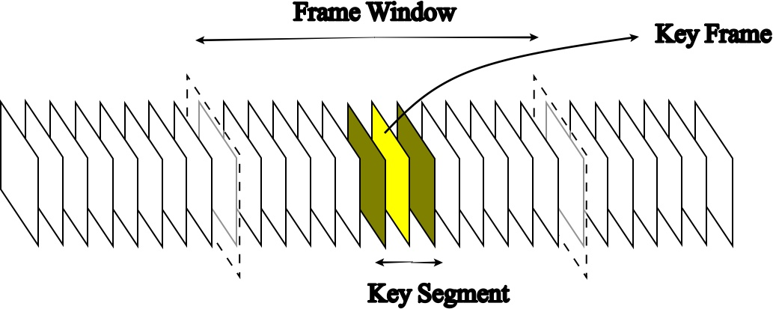
Video Watermarking(Contd.)

Slide 16
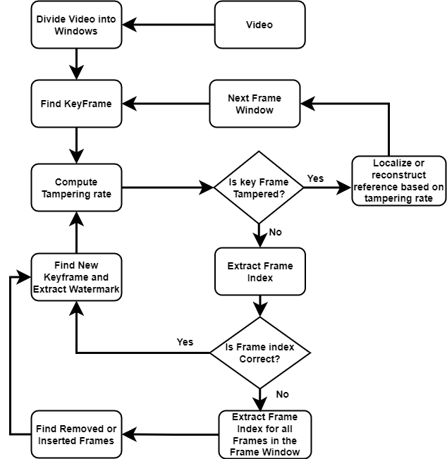
Video Watermarking(Contd.)

Slide 17
Methodology
In order to implement our watermarking system the paper we will be look into two different approaches for watermarking. One is “A novel triple recovery information embedding approach for self embedded digital image watermarking” and the other is “Pixel-wise Authentication Based Self-Embedding Fragile Watermarking Method”.
The method yielding best results keeping in view the image quality and restoration rate, will be extended to support video as well.
For video watermarking and restoration, “Video-Tampering Detection and Content Reconstruction via Self-Embedding” will be used as a reference.

Slide 18
Contributions
Current Contributions
Embedded image size along with authentication bits by reducing hash size through Blake2b library.
Usage of NumPy library to decrease processing time.
Users can add their custom key which will be used as a proof of ownership and will be used to permute recovery bits
Images are not limited to square dimension they can now be multiples of 64.
Future Contributions
Extend the paper with best results to support video tamper detection and restoration.
Add support for colored image of varying resolution.
Notes:
We are making 8x8 blocks at the end. That is our minimum requirement and total size of that is 64. Rest can be multiples of 8x8 blocks.

Slide 19
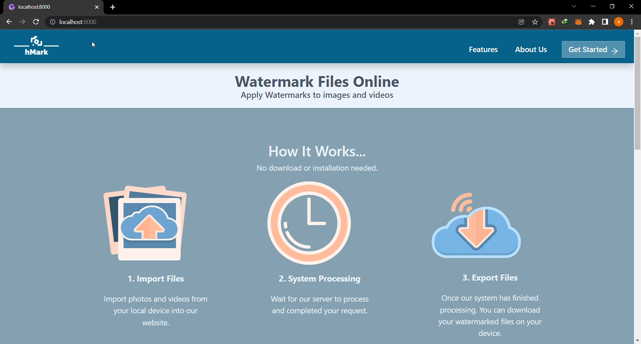
GUI (Full Screen)
25/01/2022
Self Embedding Watermarking System

Slide 20
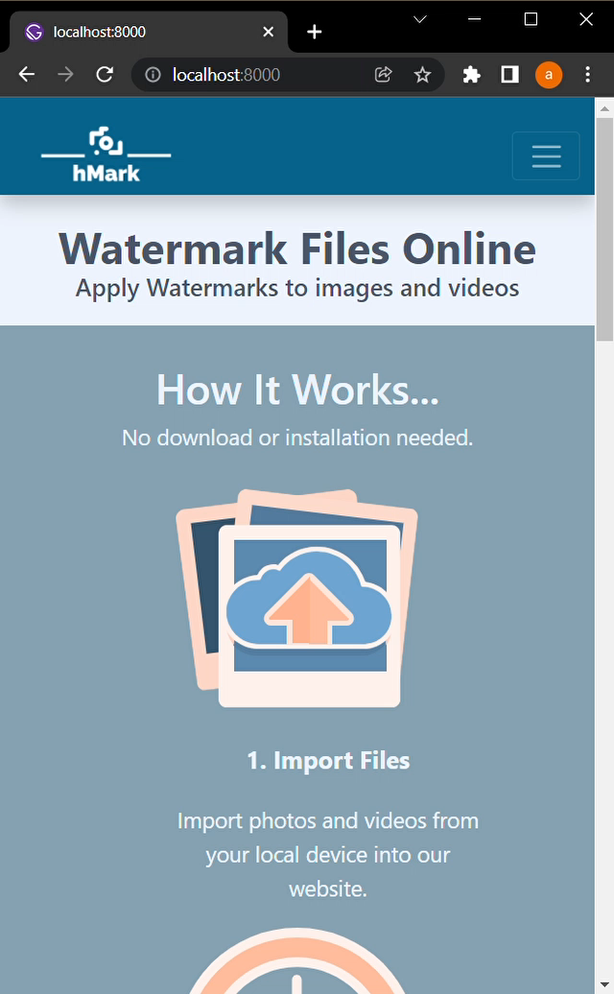
GUI (Small Screen)
25/01/2022
Self Embedding Watermarking System

Slide 21
Work Breakdown and Timeline
Nov 2021
Jan 2022 (Currently)
March 2022
GUI
Initial Research
Authentication and recovery of image
Authentication and recovery of video
Embedding process
Testing
Implementation of keyframe
extraction
Testing
Deployment
Dec 2021
Feb 2022
May 2022
25/01/2022
Self Embedding Watermarking System

Slide 22
Summary
Importance of image and video authentication
How much work has been completed?
The prototype made contain the functionalities of the image watermarking and authentication and rest of the functionalities will be implemented in FYP-II according to the above timeline.

Slide 23
Thank You!
Arbab Hamd Rizwan (18L-0765)
Usama Aslam (18L-0972)
Aashar Naseem (18L-1131)
M. Hunzlah Malik (18L-1139)
Any Questions?
Notes:
Not same as adding logo over image but its DIGITAL WATERMARKING
Temporal Tampering: Manipulating frame sequence
Spatial Tampering: Manipulating objects in frame

Slide 24
References
Guo, J., Karpman, P., Nikoli´c, I., Wang, L., & Wu, S. (2014). Analysis of blake2. Retrieved January 24, 2022, from https://eprint.iacr.org/2013/467.pdf
Yanjiao Shi, Miao Qi, Yinghua Lu, Jun Kong and Danying Li, "Object based self-embedding watermarking for video authentication," Proceedings 2011 International Conference on Transportation, Mechanical, and Electrical Engineering (TMEE), 2011, pp. 519-522, doi: 10.1109/TMEE.2011.6199255.
Yao, Y., Shi, Y., Weng, S., & Guan, B. (2017). Deep Learning for Detection of Object-Based Forgery in Advanced Video. Symmetry, 10(1), 3. https://doi.org/10.3390/sym10010003
SADDIQUE, M., ASGHAR, K., BAJWA, U., HUSSAIN, M., & HABIB, Z. (2019). Spatial Video Forgery Detection and Localization using Texture Analysis of Consecutive Frames. Advances In Electrical And Computer Engineering, 19(3), 97-108. https://doi.org/10.4316/aece.2019.03012

